Slide 1


Leadership & Partnerships
A Human-Centered Approach to
For Community Health
Speaker: A. Berké Brown
May 22nd, 2024
Notes:
Hello everyone I want to welcome you to our deliberation on the humanity approach. This approach in its nature and from its inception is human centric. Centered upon the human expereince rather than through the lens dichotomy of good and evil us and them right and wrong. It is approach that sees all choices as an option of not being good or bad, being better or worse. More humane or less. There is a spectrum that we will travel today that will help us understand that the goal is not to be more diverese inclusive righetous anti-racist but instead be more humane more empathetic, which in turn will naturally increase a more diverse and inclusive society institution and tribe. My goal is to humanize this work so that we seek opportuntites to push te needle towards a just and humane society.
I better is possible. Good is not enough.
I’d rather be pro-peace than anti-war

Slide 2
A conversation…
“Motivation lasts a day. Inspiration lasts a season. Practical tools and a small shift in perspective will last a lifetime."
Notes:
Maintaining Humanity & Sanity

Slide 3
The Agenda
Part 1: Setting The Stage
Part 2: Perspective Shifts
Part 3: Human Centered Leadership Approach
Part 4: Commitment & Action
Part 5: Conclusion

Slide 4
Setting the Stage
Perspective Shifts
Notes:
Understanding Customer Behavior and Emotions

Slide 5



If You Knew Me Well..

Slide 6
WHAT DO YOU SEE?
Notes:
If I stub my to million right for one wrong. If you attempt your reflection and fall short doe you the miss the good
There’s more t han meets the eye. Today as we reflect we want you to focus not the problem. But the solution Solutogenisis. factors that support human health and well-being, rather than on factors that cause disease (pathogenesis).

Slide 7

SEE THE WORLD THROUGH GRATITUDE
35% reduction in depression & stress
25% less reactive throughout day
10% increase in energy
16% fewer sick days
19% increased time exercising
10% less pain
8% more sleep & quality
Emmons, R. A., & McCullough, M. E. (2003), Seligman, M. E., Steen, T. A., Park, N., & Peterson, C. (2005) Toepfer, S. M., Cichy, K., & Peters, P. (2012)
Notes:
Gratitude is not good because it holy. It’s good because it clears the mind. It clears focus REDUCES YOUR COGNITIVE LOAD SO THAT YOU CAN ENDURE CHANGE. IT SET’S THE STAGE

Slide 8
Defining Our Terms
Pathogenesis
Definition of pathogenesis
: focus on the origination and development of a disease
Notes:
Before we dive in let's make sure we're all clear on the reason for our wording. In research, before we begin any conversation, we must first define terms. If we do not do this we lose the ability to communicate through misinterpretation. So let's begin this by defining our terms of humane and inhumane We are our environment.

Slide 9
WHAT DO YOU SEE?
Frustration
Issues
THE PROBLEM
Anxiety
Stress
Notes:
There’s more than meets the eye. Today as we reflect we want you to focus not the problem. But the solution Solutogenisis. factors that support human health and well-being, rather than on factors that cause disease (pathogenesis).

Slide 10
Defining Our Terms
Salutogenesis
Definition of salutogenesis
: an approach to human health that examines the factors contributing to the promotion and maintenance of physical and mental well-being rather than disease with particular emphasis on the coping mechanisms of individuals which help preserve health despite stressful conditions

Slide 11
WHAT DO YOU SEE?
THE SOLUTION
Notes:
SALUTOGENISIS!! There’s more t han meets the eye. Today as we reflect we want you to focus not the problem. But the solution Solutogenisis. factors that support human health and well-being, rather than on factors that cause disease (pathogenesis).

Slide 12
MAKING THE DIFFERENCE
What the Vision Does
Creative Tension
Current Reality
Vision
PETER SENGE 2006
Notes:
This shift in thinking causes a transformation The clearer your vision is the more it will “pull” your current reality to it

Slide 13
The Champion Provider Fellowship Vision
"Improving the health of local communities beyond the clinic by leveraging the power of healthcare providers."
- Champion Provider Fellowship Mission
Notes:
Understanding Customer Behavior and Emotions

Slide 14
What is Human-Centered?

Slide 15
Human Centered Approach
Notes:
Planting it in Human Centered
Creating Lens through which to look
Research Based -Values & Purpose Based Change
Knowledge isn’t enough

Slide 16
Defining Our Terms
Humane
adjective
characterized by tenderness, compassion, and sympathy for people and animals, especially for the suffering or distressed
acting in a manner that causes the least harm to people or animals:

Slide 17
Defining Our Terms
Inumane
adjective
not humane; lacking humanity, kindness, compassion, etc.
lacking qualities of sympathy, pity, warmth, compassion, or the like; cruel; brutal:
apathy

Slide 18
Redefining Cultures: Human-Centered
The human-centered culture is one that exists to fulfill a purpose for its customers, patients, staff and community, and orients all of its innovation and operations activities around those people. It has instilled the principles of human-centered design and applied them in their most pure form to every aspect of their organization.
focuses on creating better human experiences
builds resilience and de-risks innovation through continuous iteration and learning
cares as much about the experience of its diverse, empowered teams as it does about its patients and community
intentionally, actively embeds these principles into the fabric of the organization
https://www.ibm.com/design/thinking/page/hco
Notes:
Being Human Requires being humane

Slide 19
Human Centered
Teammate
Servant
Leader
Human
Notes:
Human centered means you start ALWAYS with the human in mind. The person. The people.

Slide 20
WHAT DO YOU SEE?
Burnout
Slow Progress
THE PROBLEM
Conflicting Demands
Lack of Appreciation
Notes:
So what do you see? These exist but if its what you say you get bogged. The goal all my work and research is to Cognitive Real Estate is finite. And if you aren’t clear on why how and what you will be overwhelmed. Cognitive space.

Slide 21
WHAT DO YOU SEE?
The Human
The Leader
THE SOLUTION
The Servant
The Team
Notes:
The glass is not half empty or half full. It’s halfway. I want as leaders to be realist. To be planted in reality with our mind towards our vision. Undeterred. LET’S HOP IN

Slide 22
The HUMAN
Notes:
The Human. Everything I do is around the human. Our natural drivers are human drivers. My research was the study of blah blah
What makes humans move consistently towards their greatness.

Slide 23
I AM

Slide 24
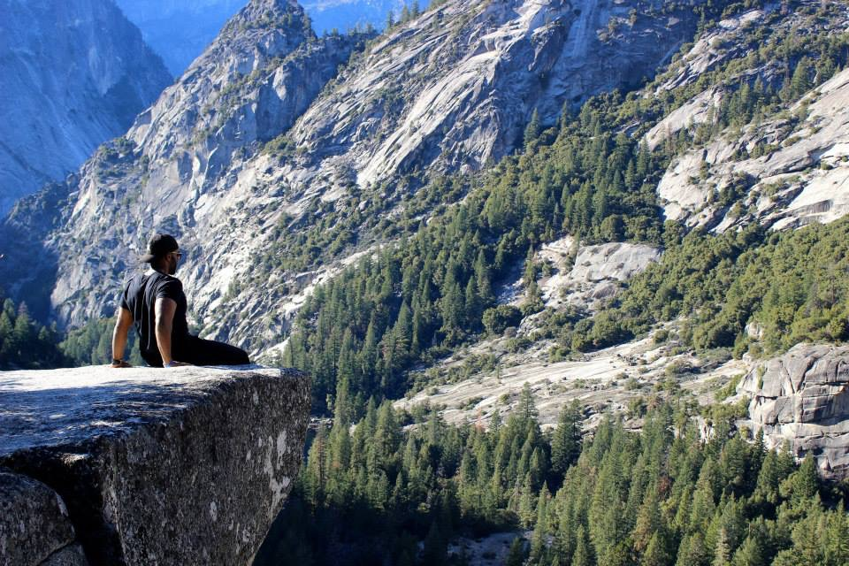

I AM A ROCK
THAT HAS LEARNED TO FLOAT.
WHEREVER THE MAIN STREAMS
AND CURRENTS WILL GO.

Slide 25


I AM A BIRD
THAT HAS LEARNED TO WALK.
FORSAKING THE HEAVENS
TOO AFRAID TO FALL.

Slide 26

I AM A WINNER
WHO HAS SETTLED FOR A TIE
BETWEEN LIVING THE TRUTH AND LIVING A LIE.

Slide 27

I AM A GENIUS
WHO HAS LEARNED TO SLEEP.
ON THE BACKS OF FOOLS,
ONWARDS, TOWARDS NAIVETY

Slide 28

I AM A STAR
THAT HAS LEARNED TO EXTINGUISH ITS LIGHT,
SO IT WON’T FEEL ALONE IN THE DARKNESS OF NIGHT.

Slide 29
AFRAID TO BE SEEN OUTSHINING THE REST,
WE LIVE IN DENIAL SACRIFICING OUR BEST.

Slide 30
FOR THE LOVE OF BLIND MEN LEADING THE WAY,
WE SELL OUR TOMORROWS JUST FOR ONE DAY.

Slide 31

BUT I AM A SEED
PREDESTINED AND FORMED.
TO GROW INTO THE MOLD
TO WHICH I WAS BORN.

Slide 32


SO BEFORE I LIVE THESE GOD SENT DREAMS,
I MUST FIRST FORGET TO LEARN, AND JUST BE ME.
Notes:
I wrote this poem 10 years ago. In its essence it is a reminder that sometimes learning and lectures, tools kits steps, can inhibit us from doing and being what we naturally are inclined to do.
Humans are naturally communal species. They are interdependent and need each other to exist.
My goal in sharing this poem was to humanize me. I could easily come as a title with my profession leading the way, an authority or expert WHEN PEOPLE MEET YOU they ask you what you do… NEXT SLIDE

Slide 33
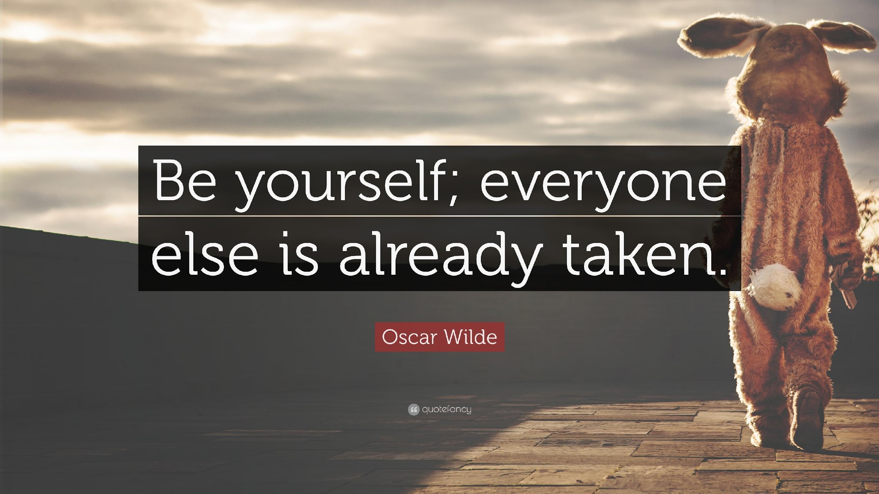

Slide 34

Who am I?
What do you do for a living?
I am…
Organizational Consultant
Leadership & Mindset Coach
UC Berkeley Alumni
Behavioral Researcher
Educator/Speaker
Diversity Consultant
Musician
Singer Songwriter/ Lyricist
Poet
Consultant
And I am not…
Notes:
WE HAVE TO GET TO THE SOURCE OF IT. I am a Organizational... These are just different manifestations of who I am. At the end of the day I’m just a HUMAN who wants to have a powerful conversation with you
There’s more to me as there is more to you and just your title there are people here

Slide 35
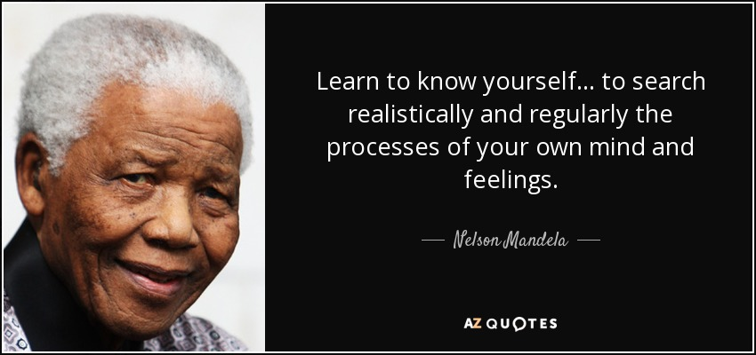
Know Thyself …
Notes:
Values produce intrinsic motivation
00:20:22Then I talked about values external motivation is focused on punishment reward obligation basic
00:20:28A yeah you bring up that policy as well.
00:20:32Right. And the problem is is overwhelming for people in there. Like, I don't want to do it. I feel obligated. But then if you get if you hit the internal motivation, the achievement trust curiosity satisfy

Slide 36

Mission
Values
Vision
Process of Purpose
Notes:
My goal is for you to see yourself this way and not only you but your coworkers your team your department etc. This is the lens
The mission statement supports the vision and serves to communicate purpose and direction to the faculty, students parents, and other stakeholders.
The mission can change to reflect the institutions or department’s priorities and methods to accomplish its vision

Slide 37


VALUES AND INTERNAL MOTIVATION
Punishment
Reward
Obligation
Basic Need
Creative Desire
Achievement
Interest/ Curiosity
Satisfaction
Tied to bigger
Notes:
Values produce intrinsic motivation
00:20:22Then I talked about values external motivation is focused on punishment reward obligation basic
00:20:28A yeah you bring up that policy as well.
00:20:32Right. And the problem is is overwhelming for people in there. Like, I don't want to do it. I feel obligated. But then if you get if you hit the internal motivation, the achievement trust curiosity satisfy

Slide 38
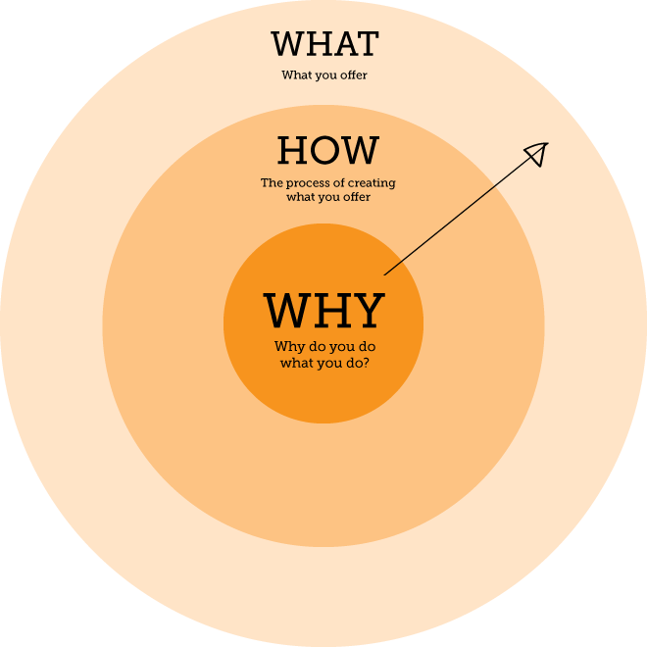
Why We Do It
Notes:
You know simon sinek raise
You now know my why
This speech displays my how
And at the end of this speech you’ll see what i do…
People don’t care about what you do they care about why… Share your why as an example for them to know there why

Slide 39



Vision
Values
Growth
Adventure
Creativity
Excellence
Notes:
Values. How does it show up, it shows up in my missions. Right. And my missions are not just this one thing that I do because I'm multifaceted right and so I talked about. There's more to me just as there's more to you just as blah, blah, blah, blah, blah. Um, and then

Slide 40
VALUES MATTER:
YOUR Values
Notes:
Intrinsic Values Environment Transformative Curve
Thank you. I'm praying. This was what I wanted. So how do we make this stick right how do we create an environment that's healthy and then also personal actions small activism that's healthy right

Slide 41

VALUES
Faith
Fame
Friendship
Growth
Happiness
Honesty
Humor
Influence
Inner Harmony
Loyalty
Meaningful work
Adventure
Arts
Authenticity
Acknowledgement
Beauty
Boldness
Compassion
Community
Creativity
Curiosity
Determination
Fairness
Peace
Pleasure
Optimism
Recognition
Religion
Reputation
Service
Spirituality
Success
Wisdom
Other
Notes:
Choose your top 10 Top 5 Top 3.
Now define your top 3
Choose a time one of those values were engaged or experienced
00:23:53Now I want you to choose out of those 10 your top for everybody has such a difficult time doing that. There's usually in the audience are like, Oh my god, I can't cut it down to four.
00:24:02And I'm going to say that when you're clear on what you are, what you care about, you'll be clear on what you don't care about
00:24:06When you stand for, you know, what you'll stand against right
00:24:12That's one of the most important things for you as a human to be a successful human human is to live by your values. And the same thing goes for the institution.

Slide 42
BRINGING THEM TO LIFE
What do they mean to you? Define them.
How do they display themselves in the real world? Personify
Notes:
Values remind us why? What for
Imagine if you keep your values in front of you in decision making when you’re talking to the community.
Imagine if you know the values of others.

Slide 43

The HUMAN
Perspective Shifts & Practical Tools
Knowing your story clarifies your “Why”
COMMIT: How will you show up as a human at work?
Try this values exercise with your team
Work to understand the values (drivers) of your employees, patients potential partners and community. This is emotional intelligence.

Slide 44

Before you Build the Future
You Must be Present

Slide 45
The LEADER
Notes:
Once you know who you are at the core fundamental level. That clarityt create a real foundation to become a true leader. Leader
(Stay Resilient and Focused)
Mission
Tough decision
Balance
Loss is control demands freon state 27min
Resilience Mantra
Change
But and

Slide 46
How We Do It
Notes:
You now know my why
This speech displays my how
And at the end of this speech you’ll see what i do…
People don’t care about what you do they care about why… Share your why as an example for them to know there why

Slide 47
Mission
Values
Vision
Driven by Mission
Notes:
The mission statement supports the vision and serves to communicate purpose and direction to employees, customers, vendors and other stakeholders. The mission can change to reflect a company’s (or department’s) priorities and methods to accomplish its vision

Slide 48
“I BERKÉ BROWN EMPOWER CHANGEMAKERS BY MEETING THEIR NEEDS FOR TOOLS AND GUIDANCE THAT FOSTER INNER CONFIDENCE AND THE WILL TO SUCCEED WITHIN THEM.”
My Mission
Notes:
This what I am here to do. Regardless of who appreciates this talk or not. I am here doing something that existed before I knew I would be speaking here. This is a manifestation and so I engage in it with my whole self.

Slide 49

Leaders focus on the goal, the rest focus on everything else.
Mission Driven
Notes:
“Winners Focus on Winning Losers Focus on Winners”
ake work through this major spot, this is really where I focus the energy is how do we get through the valley of despair. Everybody starts well. But do people in well. And so that's one of the things that I always hit on whoops.
00:18:30Okay, cool, cool, cool. So this is just going to pretty much just talk about, you know, as we make these efforts to make these changes. We're going to start off with optimism and as time goes by.
00:18:40Informed pessimism. The valley is where we're like, can we even really gain traction on creating this multiverse case in this human ization that's where we give up and start over. And this is where most of the stories end, but we're trying to do.
SETUP: we're trying to provide tools to get you to be able to push back up into informed optimism. So that success and fulfillment can happen right and then

Slide 50
CLARIFYING YOUR MISSION
Who are you? (Name and role)
What do you love to do in your work? (teach, create, clarify, connect, empower what are you meaningfully qualified to provide to others?)
Who do you do it for?
What do those people want or need?
How are they changed as a result of you?

Slide 51
Your Mission Builds Resilience
Ability to adapt and recover from challenges
Maintaining positive outlook during adversity
Key factor in good mental health and well-being
Inclusive by nature

Slide 52
The LEADER
Perspective Shifts & Practical Tools
Memorize your Mission. This is your “ Leadership Mantra”
When the right thing is done…
Celebrate every step . It’s Marathon.
You may think your contribution is small, it makes a big difference.
Notes:
You love your city want to make it better, or keep it going. in the face of adversity of people yelling at you, and making unpopular decisions, you have this as a mantra
Watch your Buts --Yes but Mission. Or Yes and
Hard Times Create Strong Leaders -Covid made people yell at you. this is growing you as a person and leader to see all perspectives mandates citizen and your desires. Helps you as person. Covid made it easier to be yelled at
Define Reality. Say it Like it is. Leaders sometimes disappoint. That’s okay. In section we’ll explain warmer tone.
Celebrate Every Step
Leader Define Real
How do you deal with frustration---
How do you get your message out and explain the balance?
Civic Not Happy
it seems like the the overarching reason why they became a planning commissioner, just because they love their city or town, you know, and want to make it better, or keep it going. And so I think I would think just as a commissioner in the face of adversity of people yelling at you, and making unpopular decisions, you kind of have your own mantra already, you know, I'm doing this f
Leader Session
But the frustration is very public, and they take it out on staff and the public to where it was very ugly, you know, and you can do anything to quell their frustration, but when they just don't want to follow state law,

Slide 53
The SERVANT
Notes:
Once you have shown up as a leader. Can speak TRUTH

Slide 54
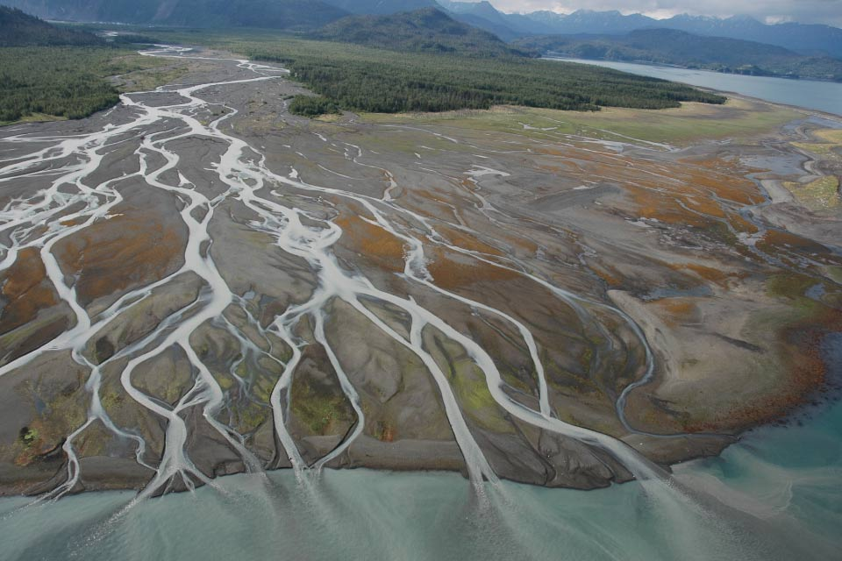
Why is the sea king of a hundred streams?
Because it lies below them.
Therefore it is the king of a hundred streams.
If the sage would guide the people, he must serve with humility.
If he would lead them, he must follow behind.
In this way when the sage rules, the people will not feel oppressed;
When he stands before them, they will not be harmed.
The whole world will support him and will not tire of him.
Because he does not compete,
He does not meet competition.
True Leaders, Serve.
Tao Te Ching - Lao Tzu - chapter 66

Slide 55
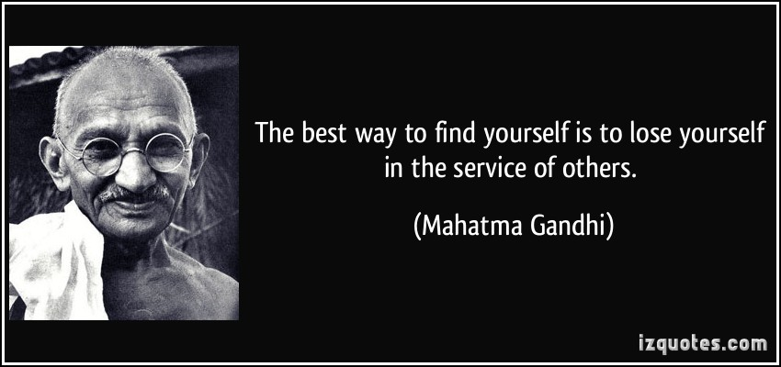
Service to a Greater Cause
Notes:
The pandemic but the powerful and crucial work you do at the fore front of every human being. Unsung heroes.

Slide 56
Vision: Champion Providers
The Champion Provider Fellowship harnesses the passion of healthcare providers to improve the health of their communities beyond the clinic setting. The California Department of Public Health and the University of California, San Francisco launched the program in 2014 to empower, train and support healthcare providers to use their expertise and respected voices to improve the health of communities through local policy, systems and environmental changes.
Servant Leaders
Notes:
Go into the city

Slide 57
Mission
Values
Vision
Service to a Cause
Notes:
A vision of service. Motivates. How many of you have a city vision? How many have there’s memorized? How many of you are motivated by it and make choices based off it? Now How many of you have a city planner vision?

Slide 58
“I envision a world where boundless imagination and creativity are applied to life itself, where the very art of living is mastered and evolved as each individual is empowered to express their unique greatness in the world.”
My Vision
Notes:
This screams service. This brings life and outcome to my mission. It’s full of my values.

Slide 59
Setting an Internal Vision
What is your vision for a thriving community?
or
If your fellowship did an extraordinary job at achieving that vision, what would your county look like and feel like to live in?
This is your cause.
Notes:
The clearer your vision is the more it will “pull” your current reality to it—We’re going to talk briefly about issues that need to be improved but first start with end in mind? Vision: Whom do we see? What do we see as a result of our work?
The FREEDOM to
decide what you’ll
attach your life to.
What a Vision gives You
The POWER that comes
from a mighty purpose.
The FOCUS and
alignment that follow.
Hold it loosely. Evolving.
Yet:
Yet hold it tightly. In use.

Slide 60
How You Might Draft
Draft a statement of approximately one sentence that reflects in a way your picture of your community/Dept as you would live and die to have it be.
Begin “My vision for is . . .” or “I envision a office”
Aim to describe the end condition. Go BIG.
Seek authenticity. Is it YOU?
Seek power. Does it make you want to stretch?

Slide 61
The SERVANT
Perspective Shifts & Practical Tools
Remember your Vision, share it and become it.
Who wins: Car or Driver?
Appreciation is Currency
Inclusion is Empowerment
Notes:
KEEP VISION IN MIND
Remember Who You Serve- planning touches so many different aspects of the community by building the housing by putting the land use together, that brings the whole city and how that development pattern is going to happen not just for the next few years, but for the next several generations to come.
Go Out & Seek to Understand- Don’t just look at the staff report, take a look at the site
-Talk to the people that would be directly affected with the development project
-Even people that weren't even affected with, with the project to get their perspective
-Involve them because they may be affected in the next development -- and you’ll have an ally
Communicate the “Balance” Explain the mandates. Have an open session explaining. Listening being with. Sequa, Rena numbers, affordable housing. Venn Diagram. Listening and Not brushing off
Say to public saying this is this is definitely something out of our control, this is mandated by the state,
any sanctions, that could lose significant funding
And so how the commissioners can under you know, it's almost a prospective. If the commissioners could step into staff shoes for a day and kind of say, Oh, wow, you're just trying to balance your your command. values what your city wants, but the state, especially in housing, coming down
I feel that that sense of loss of control, with everything that's coming down from the States, it's how do you do all these things that you just talked about, make the balance, make the change, we make the difference? You know, do all that, combined with the very real challenge of a lot of those things are taken out of our hands?

Slide 62
Servants Create Environments…
"Diversity is being invited to the party; inclusion is being asked to dance"
Verna Myers
Notes:
Maintaining Humanity & Sanity

Slide 63
The TEAM

Slide 64
What is our Goal?
Different Priorities and Values
Notes:
If you picture All of the people in your organization as arrows and think about where THEIR attention goes and what their focused and you think about the goals and values and priorities
Most of them are at odds with each other or at least not on the same page.
Imagine being on a rowing team and everyone is rowing in a different direction…..
When there isn’t a unified purpose or direction, momentum is so hard to create. Many organizations unconsciously work this way and are stuck.
Yes they have a a Mision Vision and Values but they banal and are not absorbed but staff. And so the organization change efforts and initiatives often fall short.

Slide 65
What is our Goal?
WHERE ATTENTION GOES ENERGY FLOWS
Notes:
There is a quote that says where attention goes energy flows
To be clear today is about powerfully starting that process and building bonds, energy, and momentum towards a clear purpose and direction.
What we want to do is to get all of us to focus and point in the same direction by focusing on building a strong and inclusive Mission Vision and Values
So let’s get to it.

Slide 66



Shifting the Perspective
Keeping it Human
Transformative
Notes:
But instead Think of organization as an organism
All working towards a worth cause cells create organs organs create organism
Natural ecosystem it’s no longer work … it just works
But if you don’t understand the function of your cell the whole organism suffers. Integrity

Slide 67
The ACTION PLAN

Slide 68
Commit & Act
"Provide pertinent health information to city commissions."
"Counsel school districts on implementing wellness policies."
"Encourage workplace wellness programs such as ParkRx and other physical activity initiatives."
"Promote the importance of Safe Routes to Schools."
"Establish policies to screen for food insecurity during pediatric patient visits."
"Support healthy retail store conversions."
"Serve as a reliable resource on health for the media."

Slide 69

Human Behavior
Behaviors
Emotions
Needs
Notes:
If I stub my to million right for one wrong. If you attempt your reflection and fall short doe you the miss the good
There’s more t han meets the eye. Today as we reflect we want you to focus not the problem. But the solution Solutogenisis. factors that support human health and well-being, rather than on factors that cause disease (pathogenesis).

Slide 70
Speak the Need, Align with the Feeling, Call to Act.
Positions
Impact
Needs
Notes:
If I stub my to million right for one wrong. If you attempt your reflection and fall short doe you the miss the good
There’s more t han meets the eye. Today as we reflect we want you to focus not the problem. But the solution Solutogenisis. factors that support human health and well-being, rather than on factors that cause disease (pathogenesis).

Slide 71

Mission-Minded Leaders are Resilient
Success & Fulfillment
Uninformed Optimism
Informed Optimism
EMOTIONAL STATE
Informed Pessimism
The Valley
Lapse/ Relapse
TIME
Notes:
Its a rocky road. Build Resilience
Change is a process. If you want it you have to be willing to commit.
ake work through this major spot, this is really where I focus the energy is how do we get through the valley of despair. Everybody starts well. But do people in well. And so that's one of the things that I always hit on whoops.
00:18:30Okay, cool, cool, cool. So this is just going to pretty much just talk about, you know, as we make these efforts to make these changes. We're going to start off with optimism and as time goes by.
00:18:40Informed pessimism. The valley is where we're like, can we even really gain traction on creating this multiverse case in this human ization that's where we give up and start over. And this is where most of the stories end, but we're trying to do.
SETUP: we're trying to provide tools to get you to be able to push back up into informed optimism. So that success and fulfillment can happen right and then

Slide 72
PULLING TOGETHER:
SHARING YOUR PURPOSE
Share your Values
Find Commonalities
Share Mission
Share Vision
Notes:
Share your these when you meet someone at this conference. BE HUMAN Centered
You all chose service because you have similar values --- find the commonalities to strengthen bond and momentum ---
Share Vision and Values 1:28 (you all have purpose cleaning roads to
1:40 I just did a 6 minute exercise with you innovative and build community build connection find them on line

Slide 73
MAKING THE DIFFERENCE
BUILDING THE TEAM BOND
Shared Mission
(Leader)
Shared Values
(Human)
Transformation
Shared Vision
(Servant)
(Team)
PETER SENGE 2006
Notes:
This shift in thinking causes a transformation The clearer your vision is the more it will “pull” your current reality to it

Slide 74
The TEAM
Perspective Shifts & Practical Tools
Share MVV
The whole is greater than the sum of the parts
Your priorities are important but remember the greater good
Seek Align Call
YOUR Vision, THEIR Language
Notes:
Team Connect With Each Other While Here
You know, it's not only just connection with with the people, but the connection for the program, the resources that are being presented as well, Team Greater Good
some they'd be really focused on parks like I, my mission is to get more parks in the city or my aspect of, you know, historic aspect or, you know, economic Right? And how do we also focus that and channel it as a group and a collective to help further the city
how do you work together as a team, to further both your interests personally, as a commissioner, which brought you to be involved with government in first place, but then also to channel that to help the greater good and beautiful?
Diff Perspectives
Bridging the Gap
30 year olds who are really looking to change the community against values that have been in place since incorporation over 40 years? I absolutely do. Think that is a huge struggle, as you're seeing the younger generation and all those baby boomers and traditional ones kind of easing out and the change
But what else is what the change is going to enhance the value that you have that community pet as the community changes demographically,
Reach out to City Staff
And say hey I need your help public asked question--- Connection
Not staff versus Commision we are all bound be the same state laws and guidelines and how to do the right thing for the state and our city at the same time.

Slide 75

Out of the Many, One.

Slide 76
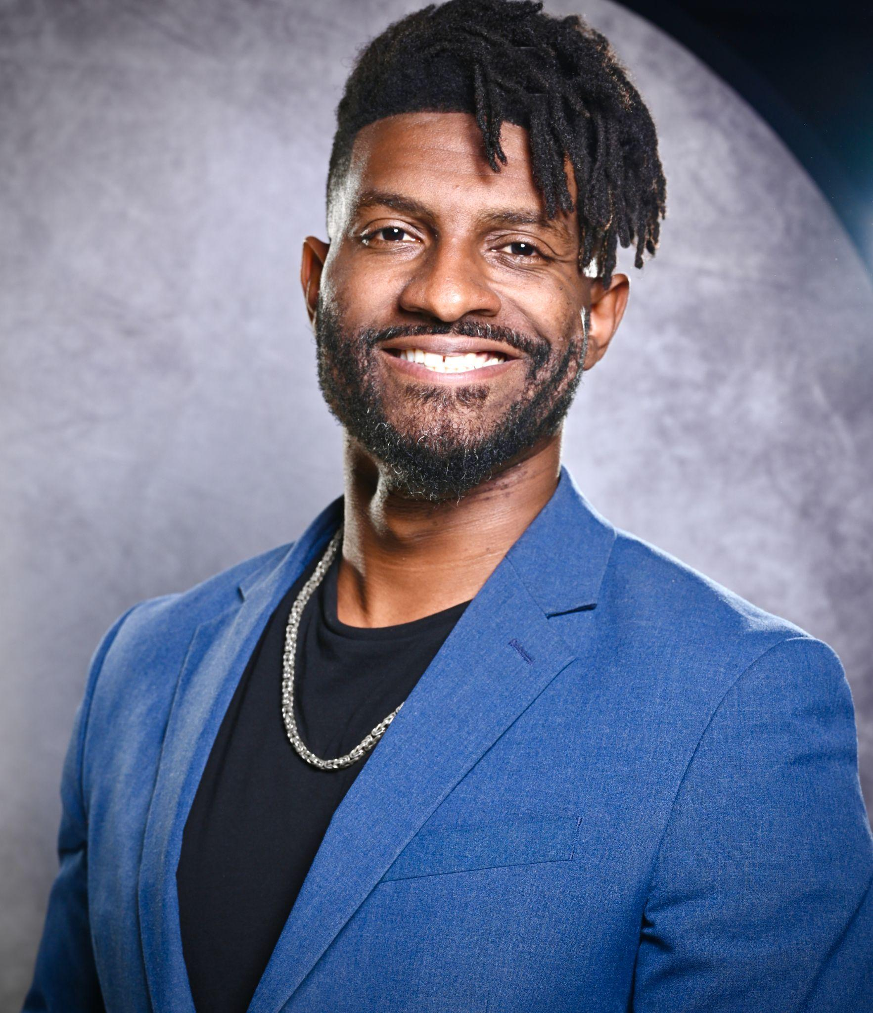
About Berké
Berké is a leading expert in motivation and behavior change. He has worked with Fortune 500 companies, organizations, and municipal governments to create sustainable changes in culture, performance, and service. Berké was awarded highest honors for his research at UC Berkeley on internal motivation and behavior change. Drawing from his awarded UC Berkeley research and years of experience as a change consultant, coach, and speaker, he creates programs and workshops empowering businesses and individuals for peak performance.
Services Include:
City Culture Realignment
DEI Consulting & Coaching
Strategic Visioning Retreats
Online Leadership & Education
Leadership/Management Coaching
City Branding & City/ Populous Relations

