Slide 1
How to use this presentation slide deck:
This is a slide deck on Safe Routes to School (SRTS) that can be completely tailored for your use.
Key target audience of this slide deck are local government officials, school officials, and/or school board members.
This slide deck provides basic talking points in the notes sections of the slides that you should update and craft to your own individual context.
Please feel free to add your own slides, talking points, images, icons, or photos to the slide deck where needed.
Double brackets [ ] are used when indicating prompts of how and where you can modify the text or slides.
Notes:
[Internal Note:
This presentation does not have to be delivered by more than one person. We’ve built into this slide deck the flexibility for Champion Provider fellows to opt into delivering this presentation with a key partner (e.g., local health department rep, a community based org rep). Throughout the slide deck, we have flagged those sections where it's clear to us that the fellow or speaking partner should be covering that topic area.
Please be sure to site original sources of information in the format that best fits your presentation.]

Slide 2
[Safe Routes to School Presentation Title]
[Name, Title, Organization
Name, Title, Organization]
[Date]
[Location]
Notes:
[display this slide while you wait to begin]
Hello! Welcome to [read aloud the title of the presentation]
My name is [blank]. I am a [title] at [organization].
[If applicable] I’m joined today by [name], [title], at [organization]. You’ll hear more from [speaker #2 name] shortly.
For folks not familiar with us, [name or org] [describe work you do]. Our mission is [insert mission statement].
We have lots to fit into this session, so let’s dive right in.

Slide 3
AGENDA
What is the purpose of this presentation?
Why should we care about Safe Routes to School (SRTS)?
How can we implement SRTS?
How to address common concerns
Q&A
Resources
Notes:
Here’s a road map for our time together:
We’ll open up with a quick discussion of why we’re here together in this room.
Next, we’ll address why we should care about SRTS.
We’ll then look at how we can implement SRTS.
After that, we’ll discuss how to address common SRTS concerns.
We’ll have some time reserved for Q&A.
And finally, we shall close by leaving with you some resources to learn more about what we covered today
How does that all sound? Great! Let’s get started.

Slide 4
AGENDA
What is the purpose of this presentation?
Why should we care about Safe Routes to School (SRTS)?
How can we implement SRTS?
How to address common concerns
Q&A
Resources
Notes:
Talking points:
So, why are we here?
What is the purpose of this presentation?
To begin to answer that, I want to transport us to another place and time…

Slide 5
Notes:
Talking points:
Do you remember what it was like to be a kid? To run, play, bike, or walk with your friends?
What you probably didn’t know was how much stronger, healthier, and happier all that physical activity made you.
And that’s what we all want for our kids, and all the other kids in our communities: to be stronger, healthier, and happier.
With busy schedules and homework and jobs and commutes, it’s really hard for families to carve out dedicated time for physical activity. One way to make time for physical activity is to encourage students to walk, bike, or roll to and from school. And people across the country are doing just that through the implementation of SRTS.

Slide 6
What is Safe Routes to School?
A growing movement making it safer & more convenient, accessible, and affordable for students & their families to walk, bike, or take public transit to school
-Safe Routes Partnership. What is Safe Routes to School? Retrieved March 12, 2020 from https://www.saferoutespartnership.org/safe-routes-school/101
Notes:
Talking points:
What is SRTS?
[Read the definition on the screen] [Source: Safe Routes Partnership. What is Safe Routes to School? Retrieved March 12, 2020 from https://www.saferoutespartnership.org/safe-routes-school/101]
Safe Routes encompasses a suite of programs, needed infrastructure and street design measures, and policies to encourage students to engage in these activities as part of their everyday commute.
Growing momentum of SRTS
Established in 2005, SRTS programs and projects have grown to the effect of having benefitted over 17,400 schools and 6.8 million children nationwide.
Low-resourced areas have also benefitted: among 8,292 schools listed by State SRTS Coordinators in SRTS project award announcements, 68% of those schools are classified as Title I schools (or, schools with low-income students).
[Source: National Center for Safe Routes to School. Creating Healthier Generations A Look at the 10 Years of the Federal Safe Routes to School Program (September 2008). http://www.pedbikeinfo.org/pdf/SRTSfederal_CreatingHealthierGenerations.pdf]
This presentation is designed to help us understand what "Safe Routes to School" is, and to help find opportunities to support implementation of Safe Routes to School. [Add objectives, if applicable: Be specific about the purpose of today’s presentation. What are you asking this audience to do or consider? What would you like for them to walk away from this presentation to know or understand better?]
[Internal note to Fellows: Refer to pp. 40-45 of the UCSF Champion Provider Fellowship PSE Playbook for more on SRTS to align this presentation w/ the Playbook]

Slide 7
AGENDA
What is the purpose of this presentation?
Why should we care about Safe Routes to School (SRTS)?
How can we implement SRTS?
How to address common concerns
Q&A
Resources
Notes:
Talking points:
So, why should we care about SRTS?
Let’s explore the evidence base

Slide 8
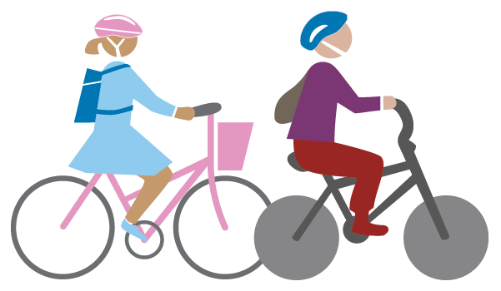
Healthier Kids
About 1 in 5 school-aged kids are obese
Walking & biking increases physical activity
Many fewer students walk or bike to school compared to 1969
-Centers for Disease Control and Prevention. MMWR: Morbidity and mortality weekly report. 2005; 54(38):949-952
-Hales CM, Fryar CD, Carroll MD, Freedman DS, Ogden CL. Trends in obesity and severe obesity prevalence in us youth and adults by sex and age, 2007-2008 to 2015-2016. Journal of American Medical Association. 2018;319(16):1723-1725
-McDonald NC, Brown AL, Marchetti LM, Pedroso MS. US school travel, 2009: an assessment of trends. Am J Prev Med 2011;41(2):146–51
Notes:
Talking points: [**Note: this slide should be delivered by the Fellow**]
A) [Set up the public health issue: Choose from these statistics below and provide any additional relevant health data regarding the health of your community.]
“Currently, 18.4% of children aged 6-11 years and 20.5% of adolescents age 12-19 years have obesity.” [Source: Centers for Disease Control and Prevention. MMWR: Morbidity and mortality weekly report. 2005; 54(38):949-952]
“Walking or bicycling for transportation increases physical activity.” [Hales CM, Fryar CD, Carroll MD, Freedman DS, Ogden CL. Trends in obesity and severe obesity prevalence in us youth and adults by sex and age, 2007-2008 to 2015-2016. Journal of American Medical Association. 2018;319(16):1723-1725]
“However, the proportion of students in grades K-8 who walk or bike to school fell from 47.7% in 1969 to only 12.7% in 2009.” [McDonald NC, Brown AL, Marchetti LM, Pedroso MS. US school travel, 2009: an assessment of trends. Am J Prev Med 2011;41(2):146–51]
B) [Present the benefits of SRTS related to health from the Fact Sheet]

Slide 9
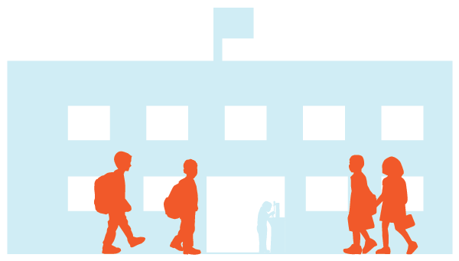
Better Academic Performance
More focused
More engaged
Better grades
-Singh, A., Uijtdewilligen, L., Twisk, J. W. R., et al. (2012). Physical activity and performance at school: A systemic review of the literature including a methodological quality assessment. Archives of Pediatric and Adolescent Medicine, 166(1), 49-55.
-Trost, s. G. (2009). Active education: Physical education, physical activity and academic performance. Active Living Research, Research Brief (Summer 2009). Retrieved December 26, 2019 from https://activelivingresearch.org/sites/activelivingresearch.org/files/ALR_Brief_ActiveEducation_Summer2009.pdf
Notes:
Talking points:
Students who exercise before school are more focused and engaged and get better grades. (1) (2)
(1) Singh, A., Uijtdewilligen, L., Twisk, J. W. R., et al. (2012). Physical activity and performance at school: A systemic review of the literature including a methodological quality assessment. Archives of Pediatric and Adolescent Medicine, 166(1), 49-55.
(2) Trost, s. G. (2009). Active education: Physical education, physical activity and academic performance. Active Living Research, Research Brief (Summer 2009). Retrieved December 26, 2019 from https://activelivingresearch.org/sites/activelivingresearch.org/files/ALR_Brief_ActiveEducation_Summer2009.pdf

Slide 10


Enhanced Traffic & Child Safety
Reduces traffic congestion
Lowers risk of collisions
Reduces pedestrian injury rate
-Dimaggio, C., &Li, G. (2013). Effectiveness of a safe routes to school program in preventing school-aged pedestrian injury. Pediatrics, 131(2), 290-296
-Muennig PA, Epstein M, Li G, DiMaggio C. 2014.The cost-effectiveness of New York City’s Safe Routes to School program. Am J Public Health; 104(7), 1294–9.
-Ragland, D. R., Pande, S., Bigham, J., & Cooper, J. F. (2014). Ten years later: Examining the long-term impact of the California safe routes to school program. UC Berkeley: Safe Transportation Research & Education Center. Retrieved December 26, 2019 from https://escholarship.org/uc/item/8m59g6vx.
Notes:
Talking points:
Getting children to walk to school reduces morning traffic congestion and lowers the risk of crash accidents. (1) (2) (3)
Sources
(1) Dimaggio, C., &Li, G. (2013). Effectiveness of a safe routes to school program in preventing school-aged pedestrian injury. Pediatrics, 131(2), 290-296
(2) Muennig PA, Epstein M, Li G, DiMaggio C. 2014.The cost-effectiveness of New York City’s Safe Routes to School program. Am J Public Health; 104(7), 1294–9.
(3) Ragland, D. R., Pande, S., Bigham, J., & Cooper, J. F. (2014). Ten years later: Examining the long-term impact of the California safe routes to school program. UC Berkeley: Safe Transportation Research & Education Center. Retrieved December 26, 2019 from https://escholarship.org/uc/item/8m59g6vx.
Multiple studies have evaluated the effects of SRTS on child safety. We’ll highlight a few here.
First, a 2014 city-wide study of a SRTS program in New York City that made changes to improve safety at the most dangerous intersections near school found a 44% reduction in the school-aged pedestrian injury rate. The interventions of this SRTS program included: setting off dedicated bicycle lanes, installing speed bumps and timing lights so pedestrians have more time to cross, and narrowing intersections by building out sidewalks. [Muennig PA, Epstein M, Li G, DiMaggio C. 2014. The cost-effectiveness of New York City’s Safe Routes to School program. Am J Public Health; 104(7), 1294–9.
Second, a statewide study of the implementation of the SRTS program in Texas found that it contributed to 404 fewer injuries to Texas school-age children each year. This is a conservative estimate when you take into account that SRTS programs were implemented in only about 443 of Texas’ estimated +9,000 schools, while the study took into account injury data across the state. Importantly, this study included not only SRTS projects that involved capital construction, but also those that included educational programs. [Dimaggio, C., & Li, G. (2013). Effectiveness of a safe routes to school program in preventing school-aged pedestrian injury. Pediatrics, 131(2), 290-296]
Third, we’ll look at SRTS programs and safety in CA. Afterall, CA was the first state to legislate a SRTS program back in 1999. A study conducted to examine the long-term impact of SRTS-funded infrastructure improvements around schools found roughly a 50% reduction in collisions involving pedestrians and bicyclists ages 5-18 in areas within 250 feet of the infrastructure improvement in relation to the area outside of this 250 perimeter but w/in a quarter mile of the school. [Ragland, D. R., Pande, S., Bigham, J., & Cooper, J. F. (2014). Ten years later: Examining the long-term impact of the California safe routes to school program. UC Berkeley: Safe Transportation Research & Education Center. Retrieved December 26, 2019 from https://escholarship.org/uc/item/8m59g6vx]
We acknowledge that there is an inherent risk in nearly every activity, including walking or bicycling to school.
However, the national SRTS program is, according to the authors of the Texas study, “perhaps the largest expenditure on school-age pedestrian safety in U.S. history.” So it should come as little surprise that this intervention is associated with “meaningful reductions in school-travel school-age pedestrian injuries.” [see above for reference]

Slide 11

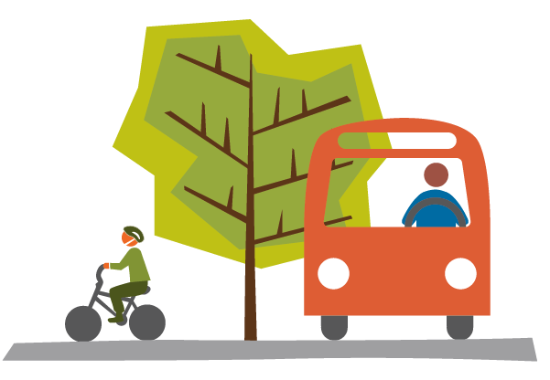

Improved Environmental Quality
Lower greenhouse gas emissions
Decreased levels of air pollution
-Mason, J., Fulton, L., & McDonald, Z. (2015). A global high shift cycling scenario: The potential for dramatically increasing bicycle and e-bike use in cities around the world, with estimated energy, CO₂ and cost impacts. Report by the Institute for Transportation & Development Policy. Retrieved December 26, 2019 from https://itdpdotorg.wpengine.com/wp-content/uploads/2015/11/A-Global-High-Shift-Cycling-Scenario_Nov-2015.pdf
-Johansson, C., Lovenheim, B., Schantz, P., et al. (2017). Impacts on air pollution and health by changing commuting from car to bicycle. Science of the Total Environment, 585-585, 55-63.
Notes:
Talking points:
Fewer vehicle trips results in lower greenhouse gas emissions and decreased levels of air pollution (1) (2)
(1) Mason, J., Fulton, L., & McDonald, Z. (2015). A global high shift cycling scenario: The potential for dramatically increasing bicycle and e-bike use in cities around the world, with estimated energy, CO₂ and cost impacts. Report by the Institute for Transportation & Development Policy. Retrieved December 26, 2019 from https://itdpdotorg.wpengine.com/wp-content/uploads/2015/11/A-Global-High-Shift-Cycling-Scenario_Nov-2015.pdf
(2) Johansson, C., Lovenheim, B., Schantz, P., et al. (2017). Impacts on air pollution and health by changing commuting from car to bicycle. Science of the Total Environment, 585-585, 55-63.

Slide 12
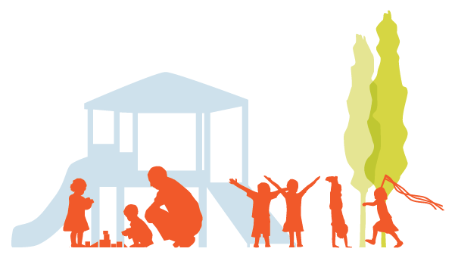
Community Connections
Increases family & community engagement
Reduces social isolation
-NEED REFERENCE
Notes:
Talking points:
SRTS provides opportunities for increased family and community engagement.
This increase in family and community engagement reduces social isolation and provides positive social opportunities and connections for students, families, and community members.

Slide 13
[Community Health Slide]
[Include statistics, comments, and images about the health of your community here to provide background and context about why SRTS is an important issue in the community you are working in.]
[Example: Obtain & share specific health data on your community’s obesity and physical activity rates in school-age children, as well as in adults who are likely to be in the age range of those walking kids to school.]
[Example: Present a patient story that encapsulates the health challenges faced by similarly situated community members.]
Notes:
[General notes:
Some common sources of data to get you started include:
California Health Interview Survey (CHIS): http://healthpolicy.ucla.edu/chis/Pages/default.aspx
500 Cities data provides health data for the largest 500 cities in the U.S.: https://www.cdc.gov/500cities/index.htm
County Health Rankings: https://www.countyhealthrankings.org/
The local health department may also be a wealth of information about the health status of your community.]

Slide 14
AGENDA
What is the purpose of this presentation?
Why should we care about Safe Routes to School (SRTS)?
How can we implement SRTS?
How to address common concerns
Q&A
Resources
Notes:
Talking points:
That all sounds great, but how do you do it? How do you actually implement Safe Routes to School in your community?

Slide 15
Programs
Policies
Notes:
Talking points:
Local Safe Routes to School efforts generally fall into two categories: programs and policies.
We'll start with programs.

Slide 16
Safe Routes to School Programs
Organized intervention
Encourage, teach & lead
Run by school district, local nonprofit, parent volunteer group, or a partnership
Notes:
Talking points:
A SRTS program is an organized intervention that’s meant to get more kids walking and biking to school.
SRTS programs encourage, teach, and help lead children in these activities.
Who’s usually in charge of running SRTS programs?
They can be run by a school district, a local nonprofit, a parent volunteer group, or a partnership of these groups.

Slide 17
The Six Es
#1: Engagement
#2: Engineering
#3: Education
#4: Encouragement
#5: Evaluation
#6: Equity
-Williams, H., Lieberman, M., & Zimmerman, S. (2019). Building blocks: A guide to starting and growing a strong Safe Routes to School Program. Retrieved December 26, 2019 from https://www.saferoutespartnership.org/sites/default/files/resource_files/buildingblocks_final.pdf
Notes:
Talking points:
The various activities involved in SRTS programs are commonly organized into the Six Es: engineering; education; encouragement; enforcement; evaluation; and equity. We’ll now take a look at each individually. [Williams, H., Lieberman, M., & Zimmerman, S. (2019). Building blocks: A guide to starting and growing a strong Safe Routes to School Program. Retrieved December 26, 2019 from https://www.saferoutespartnership.org/sites/default/files/resource_files/buildingblocks_final.pdf]

Slide 18
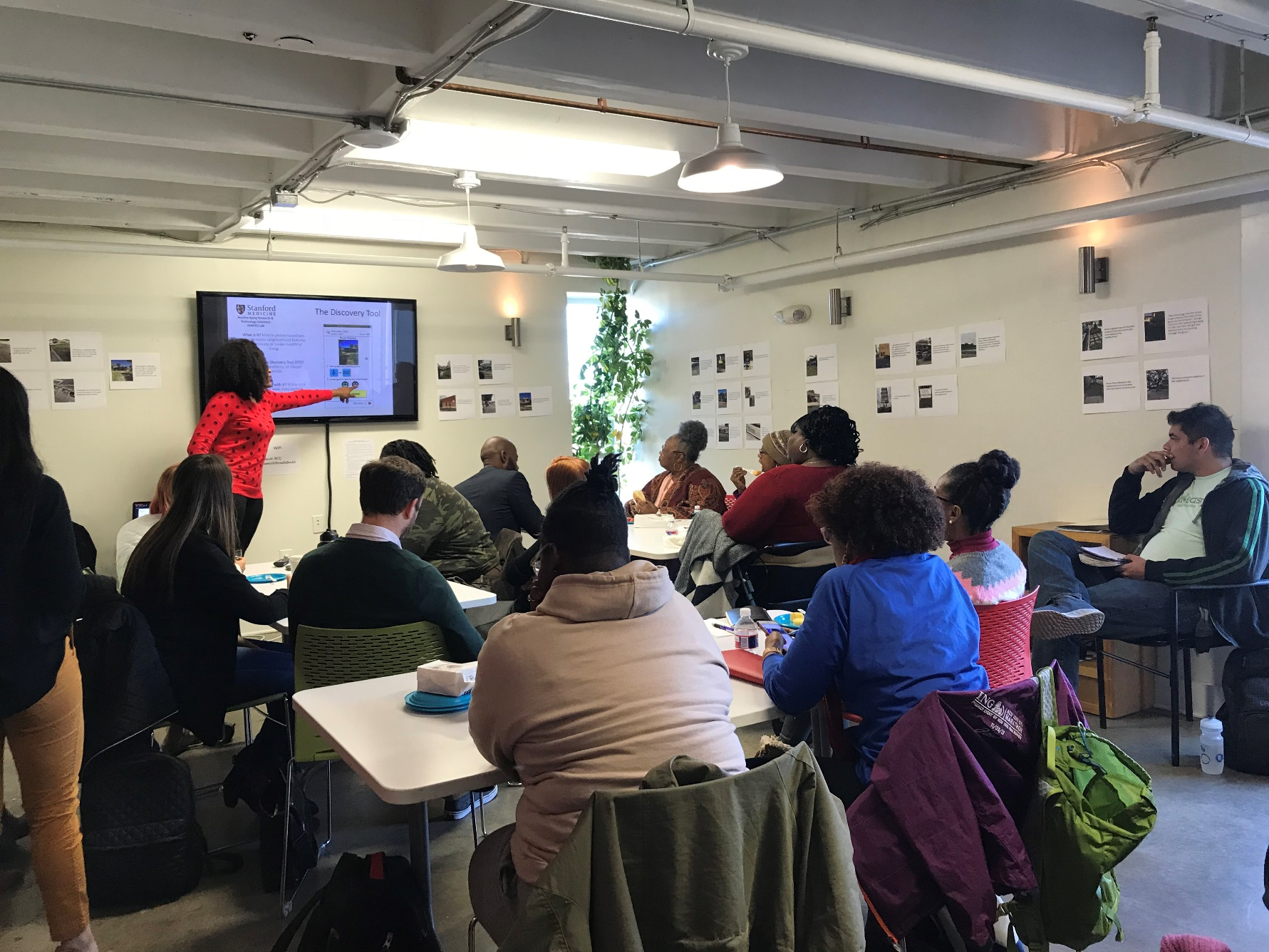
#1: Engagement
Listening to and working with stakeholders to ensure meaningful, ongoing opportunities to engage in program structure
Notes:
Talking points:
This E refers to the listening to and working with stakeholders (students, families, teachers, and school leaders) to ensure meaningful, ongoing opportunities to engage the program structure
Strategies may include: holding a town hall or community meeting, setting up a community advisory board that advises the Safe Routes to School program and meets on an ongoing basis to address program planning.

Slide 19
#2: Engineering
Physical infrastructure improvements to make roads safer to walk and bike
Notes:
Talking points:
This E refers to the design of the built environment (e.g., roads, sidewalks, street signs).
Strategies may include: improving the safety of intersections, adding or improving sidewalks and bikeways, and utilizing traffic calming measures.

Slide 20
#3: Education
Trainings or presentations
Printed material
Media outreach
Notes:
Talking points:
This E involves spreading awareness among students and the community of the benefits of walking and bicycling, and teaching pedestrian and bicycle safety skills
Strategies may include: providing in-school trainings, sending educational materials home with students, integrating SRTS into school curriculum, and community awareness campaigns.

Slide 21
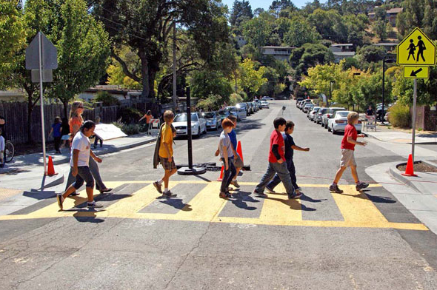
#4: Encouragement
Walk to School Day events
Remote drop-off programs
Competitions to incentivize participation
Notes:
Talking points:
This E involves generating excitement around and community support for SRTS programs.
Strategies may include: hosting Walk to School Day events, launching remote drop-off programs, and holding competitions to incentivize participation in SRTS programs.

Slide 22
#5: Evaluation
Accomplishing goals?
Supporting equitable outcomes?
Identifying any unintended consequences
Notes:
Talking points:
This E refers to assessing how well a SRTS program is accomplishing its goals.
It’s also about assessing whether programs and initiatives are supporting equitable outcomes, and identifying any unintended consequences.
Strategies may include: defining appropriate goals for the SRTS program, collecting relevant data, and periodically assessing the effectiveness of an existing SRTS program
Depending on the priorities of the community, they may choose to focus their evaluation on specific metrics including: changes in the rates of walking and bicycling to school; changes in parents’ concerns allowing their children to walk or bike to school; quality of walking and bicycling environments; number of traffic crashes involving children walking or biking to and from school; and prioritization of SRTS investments in high need areas to promote equity
Resources to learn more about metrics and measurement:
(1) SRTS Guide: Evaluation -- http://guide.saferoutesinfo.org/evaluation/index.cfm
(2) SRTS Guide: Step 3: Decide What, How, and When to Measure -- http://guide.saferoutesinfo.org/evaluation/step3_decide_what_how_when_measure.cfm
(3) Spare the Air Youth: Evaluating School Commute Programs -- https://www.sparetheairyouth.org/sites/all/themes/mtc/images/pdfs/STAY_Evaluation%20Guidebook_Final.pdf

Slide 23
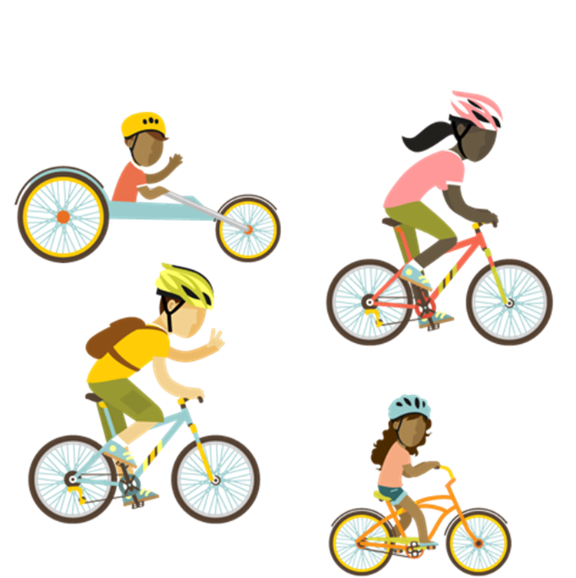
#6: Equity
Benefit all communities & demographic groups
Safe, healthy & fair outcomes for students of varying abilities
Notes:
Talking points:
This E is about ensuring that SRTS programs benefit all communities and demographic groups.
Particular attention should be paid to ensuring safe, healthy, and fair outcomes for low-income students, students of color, students of all genders, and students with different disabilities whether physical, behavioral or emotional, or intellectual, among other population groups.
Example: introducing students with varying physical disabilities to different types of adapted bikes, like a handcycle.
Strategies may include: targeting SRTS programs and investments in high-need areas, e.g., communities with high traffic injury rates, high poverty rates, and persistent health disparities.

Slide 24
Safe Routes to School Policies
Local Government Resolution (LGR)
Local School Wellness Policy (LSWP)
Planning documents
-UCSF Champion Provider Fellowship (2018). PSE Playbook: Implementing policy, system, and environmental change in our communities (Version 2). Retrieved December 26, 2019 from https://championprovider.ucsf.edu/pse-playbook.
-ChangeLab Solutions (2013). Safe routes to school: Approaches to support children walking and bicycling to school fact sheet. Retrieved December 26, 2019 from https://www.changelabsolutions.org/sites/default/files/SRTS-Brochure-FINAL-20130918.pdf
-ChangeLab Solutions (2014). Model general plan language supporting safe routes to schools: Support for proposing and adopting strong policies. Retrieved December 26, 2019 from https://www.changelabsolutions.org/product/model-general-plan-language-supporting-safe-routes-schools.
Notes:
Talking points:
Policy can be used to extend the reach of a SRTS program from a single school to an entire district or municipality.
SRTS policies support the sustainability of SRTS initiatives by institutionalizing supportive practices, providing more consistent program implementation, creating accountability, and establishing formal relationships and responsibilities. (1)
SRTS can be supported by local school wellness policies that incorporate SRTS and include, for example, on-going walking and bicycling programs, provide safe routes for bicycles through campus and ample bicycle storage, and that integrate bicycle and pedestrian safety education into school curriculum. (2)
Beyond LGRs and LSWPs, advocates can also push for the inclusion of SRTS considerations in planning documents such as general plans, active transportation plans, and bicycle/pedestrian master plans. (3) These planning documents are the community’s vision for it’s future growth and development.
(1) UCSF Champion Provider Fellowship (2018). PSE Playbook: Implementing policy, system, and environmental change in our communities (Version 2). Retrieved December 26, 2019 from https://championprovider.ucsf.edu/pse-playbook.
(2) ChangeLab Solutions (2013). Safe routes to school: Approaches to support children walking and bicycling to school fact sheet. Retrieved December 26, 2019 from https://www.changelabsolutions.org/sites/default/files/SRTS-Brochure-FINAL-20130918.pdf
(3) ChangeLab Solutions (2014). Model general plan language supporting safe routes to schools: Support for proposing and adopting strong policies. Retrieved December 26, 2019 from https://www.changelabsolutions.org/product/model-general-plan-language-supporting-safe-routes-schools.

Slide 25
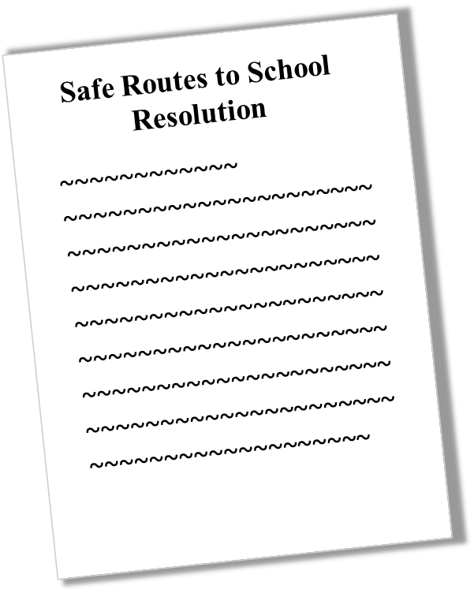
Local Government Resolution
Formal support for SRTS as a vision & goal for the community
Establish various commitments
Notes:
Talking points:
Local governments can adopt a SRTS resolution that expresses its support for SRTS through various commitments, such as establishing a SRTS task force, prioritizing infrastructure improvements near schools, and formalizing a partnership between the municipality and local school district.

Slide 26
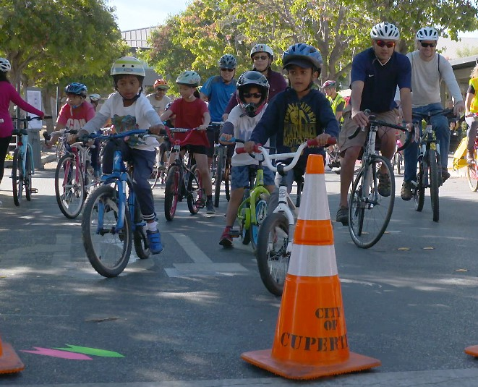
Case Study: Cupertino, CA
Local government resolution
Joint partnership
Involvement of UCSF Champion Provider Fellow
-City of Cupertino. What is Cupertino Safe Routes to School (SR2S)? https://www.cupertino.org/our-city/departments/public-works/transportation-mobility/safe-routes-2-school/what-is-cupertino-safe-routes-2-school-sr2s
-UCSF Champion Provider Fellowship (2018). PSE Playbook: Implementing policy, system, and environmental change in our communities (Version 2). Retrieved December 26, 2019 from https://championprovider.ucsf.edu/pse-playbook.
Notes:
Talking Points:
In 2015, the city of Cupertino adopted a resolution to formally support the Safe Routes to School (SR2S) Working Group and initiate a formal partnership between the city of Cupertino and the Cupertino Union School District (CUSD).
The city’s goal was to identify and address opportunities to improve safety for students walking and biking to school as well as reduce traffic congestion and air pollution.
[City of Cupertino. What is Cupertino Safe Routes to School (SR2S)? https://www.cupertino.org/our-city/departments/public-works/transportation-mobility/safe-routes-2-school/what-is-cupertino-safe-routes-2-school-sr2s.]
Pull 1-2 talking points from “Provider Role” section on Dr. Jyoti Rau in the UCSF Champion Provider PSE Playbook (at p. 44)
[UCSF Champion Provider Fellowship (2018). PSE Playbook: Implementing policy, system, and environmental change in our communities (Version 2). Retrieved December 26, 2019 from https://championprovider.ucsf.edu/pse-playbook]

Slide 27
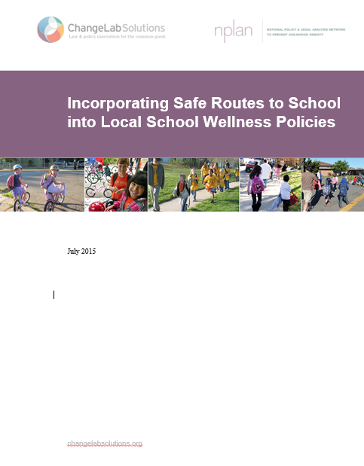
Local School Wellness Policy
SRTS task force
Prioritize infrastructure improvements near schools
Formalize partnership with municipality
Notes:
Talking points:
Local governments can adopt a SRTS resolution that expresses its support for SRTS through various commitments, such as establishing a SRTS task force, prioritizing infrastructure improvements near schools, and formalizing a partnership between the municipality and local school district.

Slide 28
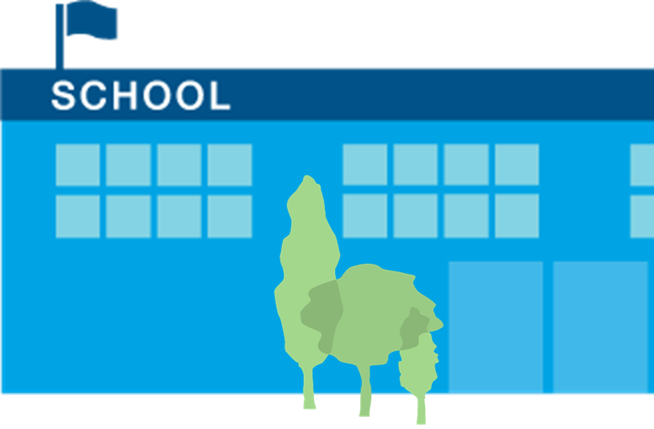
Case Study: Brawley, CA
County-wide SRTS task force
School Board adopted SRTS policy & student wellness policy
BESD SRTS Board Policy (SRTS program): http://www.gamutonline.net/district/brawleyesd/displayPolicy/627130/5
Notes:
Talking Points:
Imperial County, located in the far southeast of CA, is bordered by Arizona and Mexico, and has a population of approximately 180,000 residents.
In the mid-2000’s, the Imperial County Public Health Department received funding from CA-4-Health and convened a County-wide SRTS Task Force
The Task Force assessed opportunities to support safe bicycling and walking within small communities across the county, including Brawley, a town with a population of approximately 27,000 people, and a median household income of $32,779.
With the support of the Task Force, in 2009 Brawley Elementary School District (which serves grades K-8) adopted a board policy supporting SRTS programs and activities. The policy encourages the establishment of new SRTS programs; community evaluation regarding attitudes towards bicycling and walking to school; review of pedestrian and bicyclist injury data; and exploration of SRTS funding sources
The school district also adopted a student wellness policy that incorporates language in support of the SRTS program.
Since the adoption of these policies, BESD holds Walk to School events, provides bicyclist and pedestrian safety education, and has added bike racks to their school campuses, which benefit approximately 3,800 students.
[The California Safe Routes to School Technical Assistance Resource Center (TARC). Safe Routes To School Programs In Rural California A Guide for Communities and Partners. September 2015. See Brawly Success Story @ pg. 19]
For more info, visit:
Imperial County SRTS: http://www.icphd.org/get-involved/safe-routes-to-school/
Imperial County Safe Routes to School Regional Master Plan: https://www.cityofimperial.org/safe-routes-school-regional-master-plan
BESD SRTS Board Policy (SRTS program): http://www.gamutonline.net/district/brawleyesd/displayPolicy/627130/5
BESD SRTS Board Policy (Student Wellness): http://www.gamutonline.net/district/brawleyesd/DisplayPolicy/987883/5

Slide 29
Case Study:
Mill Valley, CA
Federal funding for nine SRTS pilots
County adopts a SRTS program
Transportation sales tax
School District Board policy
-Safe Routes to Schools/Transportation Authority of Marin. Safe Routes to Schools in Marin County Website (2019) https://www.saferoutestoschools.org/sr2s_history.html#ninetest
-Mill Valley School District Safe Routes to School (SRTS) Board Policy: https://www.saferoutestoschools.org/documents/bp_5142.2_safe_routes_to_schools.pdf
Notes:
Talking Points:
The story of incorporating SRTS into local school district policy in Mill Valley, CA is one of building upon previous successes
In 2000, the Marin County Bicycle Coalition received federal funding to develop a national model SRTS program
They used that support to fund 9 pilot projects across the county. Schools received guidance, forms, newsletters, and an array of promotional materials. Schools had walk to school days and contests to encourage participation
At the end of the pilot program, participating schools experienced a 57% increase in the number of children walking and biking
Building off this momentum, in 2003, Marin County adopted a SRTS program, and in 2004, voters passed a ½ cent transportation sales tax that dedicated 11% for SRTS programs, crossing guards, and SRTS infrastructure.
[Safe Routes to Schools/Transportation Authority of Marin. Safe Routes to Schools in Marin County Website (2019) https://www.saferoutestoschools.org/sr2s_history.html#ninetest]
Mill Valley School District had participated in that original pilot and saw firsthand the success of SRTS programs
So in 2011, the MVSD Board passed a policy that proclaimed their support for SRTS.
The policy identified key partners, required an exploration of SRTS funding sources, and identified various evaluation strategies, all to ensure sustainability of the SRTS programming in the district.
Although this was a standalone policy separate from MVSD’s wellness policy, the consideration of partnerships, funding, and evaluation in this policy, as well as the language stating the connections between SRTS and a district’s desire to support student wellness and safety and enhance student learning, are directly relevant to the language you would want to see included in a SWP.
[Mill Valley School District Safe Routes to School (SRTS) Board Policy: https://www.saferoutestoschools.org/documents/bp_5142.2_safe_routes_to_schools.pdf]
For more info, visit:
Mill Valley SD SRTS Task Force: https://www.saferoutestoschools.org/sr2s_mv.html
MVSD SRTS Resources Page: https://www.mvschools.org/domain/738

Slide 30
AGENDA
What is the purpose of this presentation?
Why should we care about Safe Routes to School (SRTS)?
How can we implement SRTS?
How to address common concerns
Q&A
Resources

Slide 31

Safety Concerns and Risk Management
Unsafe intersections & crossings
Violence & crime
High traffic speeds
& congestion
Lack of sidewalks, pathways, crossing guards & adults
Notes:
Talking points:
Often, we see that parents/caregivers willingness to allow or not allow their children to actively commute to school depends on their perceptions and concerns around safety
Common safety concerns we hear from parents and caregivers include fear over:
Unsafe intersections and crossings
Fear of violence and crime along the route
High traffic speeds and large amounts of traffic
And Lack of sidewalks, pathways, crossing guards, and adults to walk/bike with to school
However, SRTS programs are designed to alleviate these specific concerns by proactively addressing things such as making physical improvements to the built environment to promote child safety (e.g., enhancing sidewalks, crosswalks, creating bikeways, improving lighting, and involving more adults to serve as crossing guards and stewards), as well as by teaching and encouraging safe practices among pedestrians, bicyclists, and drivers.
Multiple studies have proven the effectiveness of SRTS programs in addressing these concerns, resulting in outcomes like:
Reduction in the school-aged pedestrian injury rate
Reduction in collisions involving pedestrians and bicyclists
[for more info see studies cited in slide 10]
It shouldn’t be surprising, when you consider that SRTS programs are designed to make the journey to and from school safer for children and their families through each of the 6 E’s we discussed earlier.
Finally, we acknowledge that sometimes it isn’t enough to hear about SRTS studies in other places to alleviate parental concerns around child safety. A helpful tool in this instance is to conduct a walking and bicycling audit, and invite parents/caregivers to participate, so that they themselves can examine the physical environment, and pedestrian and bicyclist behavior. This creates an opportunity for parents/caregivers to spot issues and flag safety concerns. Data from the walking and bicycling audit can then be used to inform the SRTS program, specifically how it will address these concerns. Following the audit and the development of the SRTS program, it is critical to continue to update parents and caregivers on progress in addressing their safety concerns to alleviate apprehension and increase buy-in going forward.

Slide 32
Liability & Risk Management
Lawsuit if an injury or problem arises
School district subjected to direct liability
Commonsense practices minimize risk
Notes:
[General notes: Depending on the audience, this topic of liability and risk management may not be appropriate. However, this information is included in this slide deck in case this is an appropriate topic to cover with your audience.]
Talking points:
Concerns around liability can sometimes serve as an impediment to SRTS policy adoption and program implementation
Flag that communication and documentation are key to SRTS risk management and safety
Additionally, commonsense precautions go a long way toward avoiding liability risk.
In fact, well-run SRTS programs can reduce schools’ risk of liability by identifying potential dangers and putting in place measures to protect children against injury
If relevant to the audience, flag pages 3-5 of this Changelab resource on considerations for district-run SRTS programs vs volunteer-run SRTS programs: https://www.changelabsolutions.org/sites/default/files/SRTS-Remote-Drop-Off-Rural_School_Districts-FINAL_20140611.pdf
Also flag this ChangeLab product on minimizing liability risk w/ regard to SRTS: https://www.changelabsolutions.org/product/minimizing-liability-risk
Be sure to mention that they should consult a local attorney or risk management professional (as you are not an attorney and cannot afford advice), and check with their school’s insurance policy to see if SRTS is covered.

Slide 33
AGENDA
What is the purpose of this presentation?
Why should we care about Safe Routes to School (SRTS)?
How can we implement SRTS?
How to address common concerns
Q&A
Resources

Slide 34

Resources
UCSF SRTS Success Story: bit.ly/2MaeAUI
Safe Routes Partnership:
bit.ly/2Maz7bw
National Center for Safe Routes
to School: bit.ly/2SapiOw
Incorporating SRTS into Local School Wellness Policies: bit.ly/2SapiOw
SRTS Fact Sheet & Infographic: bit.ly/2S9RLUU
Notes:
[Provide overview of these various resources]

Slide 35
Keep the Conversation Going!
[Presenter Name]
[Contact Information]
Notes:
[Thank you! + share contact info]

